Slide 1



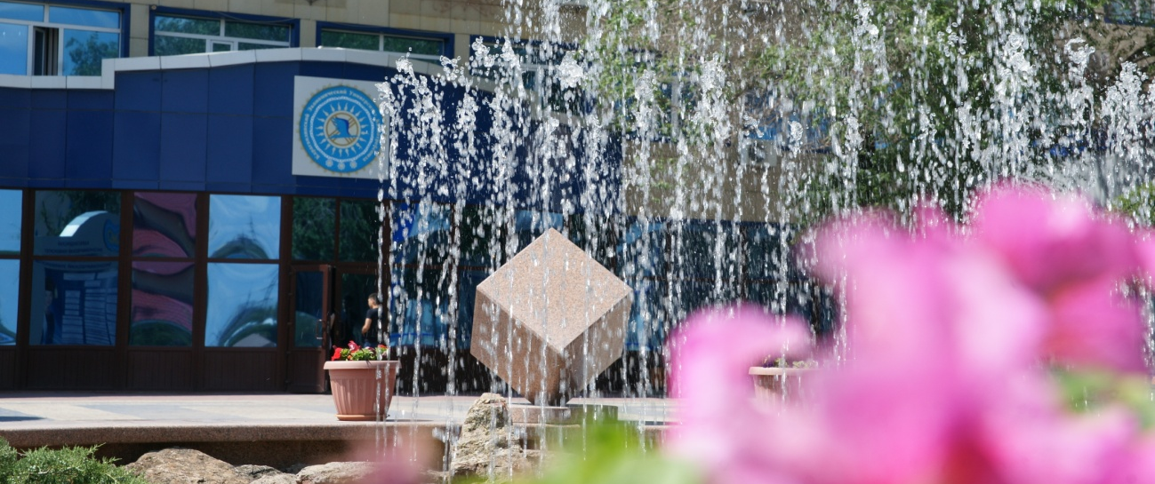
Karaganda Economic University of Kazpotrebsoyuz
Kazakhstan
Director of strategic development department,
Karaganda Economic University of Kazpotrebsoyuz
Dr. Sci. (Pedagogy), Professor , Mulikova Saltanat Altayevna

Slide 2

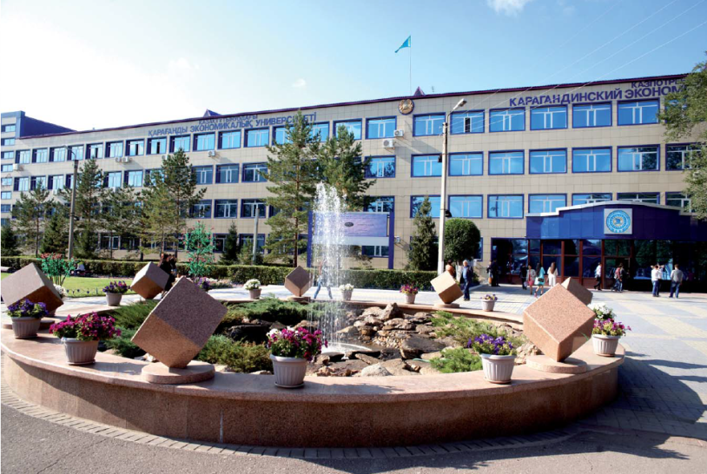


About KEUK
Karaganda Economic University of Kazpotrebsoyuz was established in 1966 as the Karaganda Cooperative Institute of Centrosoyuz, later in 1997 after passing the state certification the institution was renamed and received status of the university. The following year the university celebrates its 50th anniversary.
According to the national university rankings it is ranked as 2nd among the humanitarian and economic institutions for the third time.
Education is carried out on all three levels of the national education system: Bachelor - Master - Doctorate PhD
In accordance with the state license university realizes 21 educational program of higher education and 16 post-graduate programs.
www.keu.kz

Slide 3
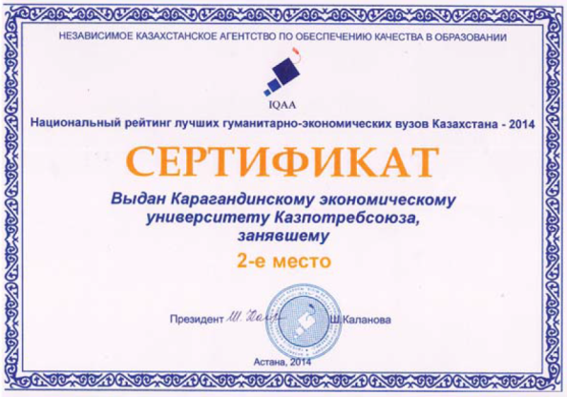
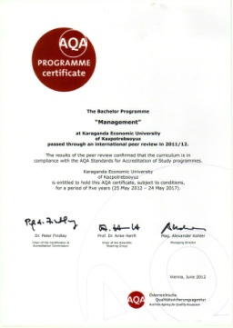

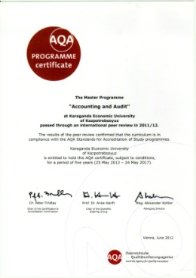
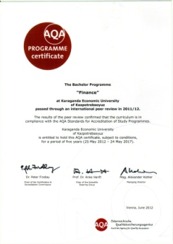
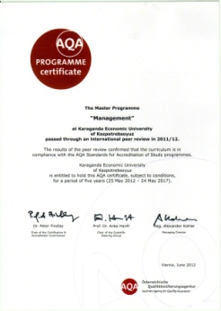

About KEUK
In 2014 university passed through:
- Institutional accreditation in Independent Kazakh Quality Assurance Agency for Education (IQAA).
- State certification of the Ministry of Education and Science of the Republic of Kazakhstan..
University has certified quality management system IQNet.
Three educational programs - "Accounting and audit", "Finance", "Economics" received international specialized accreditation until 2017 at the Austrian agency for quality assurance.
15 educational programs have specialized accreditation certificates.
www.keu.kz

Slide 4
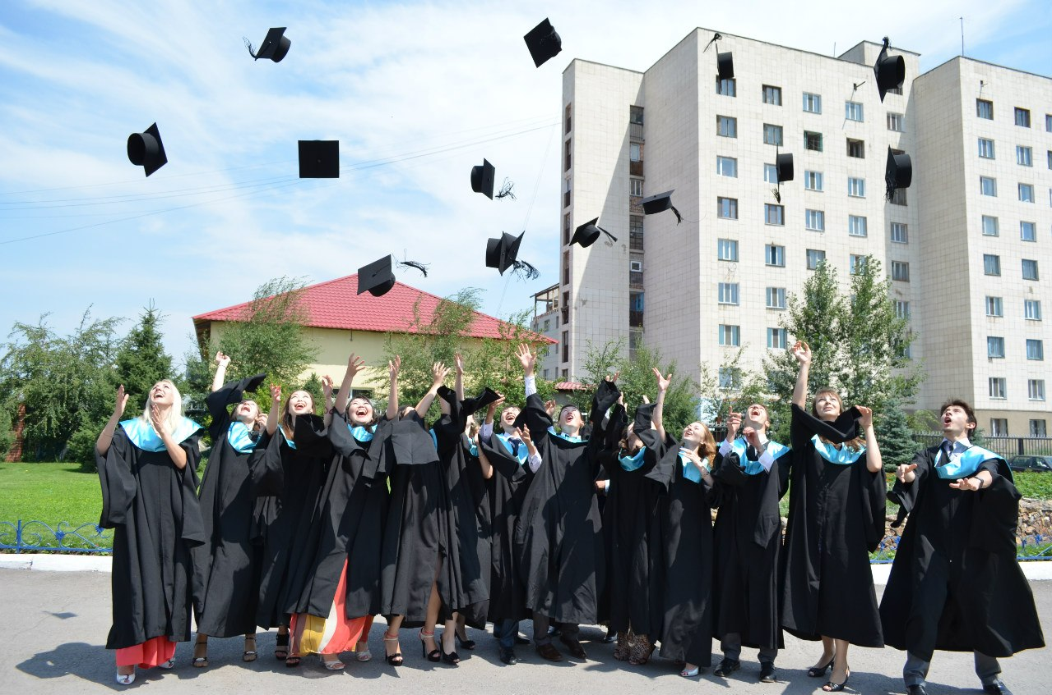
About KEUK
The activities of the Karaganda Economic University of Kazpotrebsoyuz generally defined by its mission, which spots the university’s place in the uniform educational space of Kazakhstan:
“Being one of the leading economic profile university of Kazakhstan, KEUK positioning itself as an innovative university which implements educational and scientific policy as a basis for professional growth and personal development of specialists for the economy of Kazakhstan; striving to achieve a competitive position in the world educational space."
www.keu.kz

Slide 5
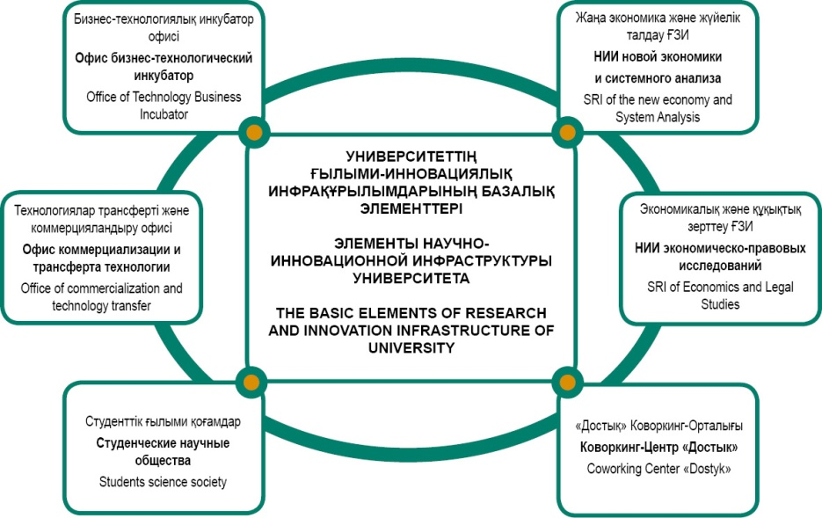
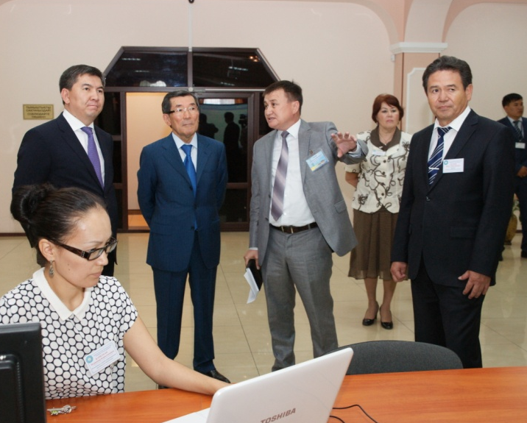
About KEUK
With the aim of maximization of educational services customers’ claims satisfaction 4 faculties are established and operating:
- Faculty of economics and management;
- Faculty of accounting and finance;
- Faculty of business and Law;
- Extramural and evening or distance learning faculty.
The university has settled and successfully operating basic elements of science and innovation infrastructure which includes 2 Research Institutes (SRI of new economy and SRI of economics and legal studies), 2 scientific office (Office of Business and Technology Incubator and the Office of commercialization and technology transfer), the main task of which is aimed at the creation of favorable conditions for the implementation of scientific and innovative projects of students, undergraduates, doctoral students and faculty of the university.
The contingent of students counts 4088 people, including 168 graduate students and 10 doctoral students.
www.keu.kz

Slide 6
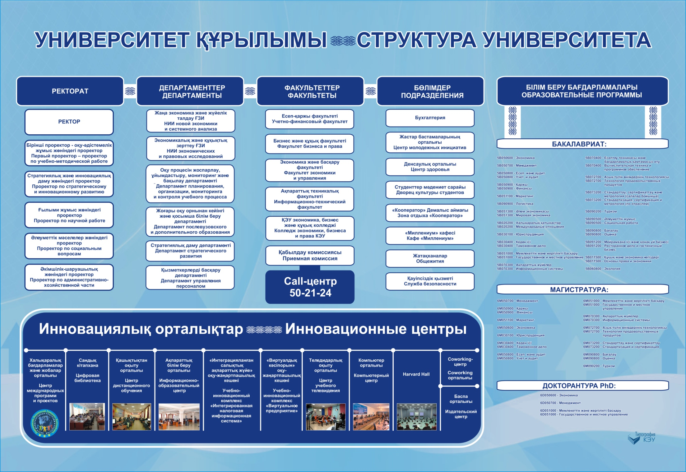

Slide 7
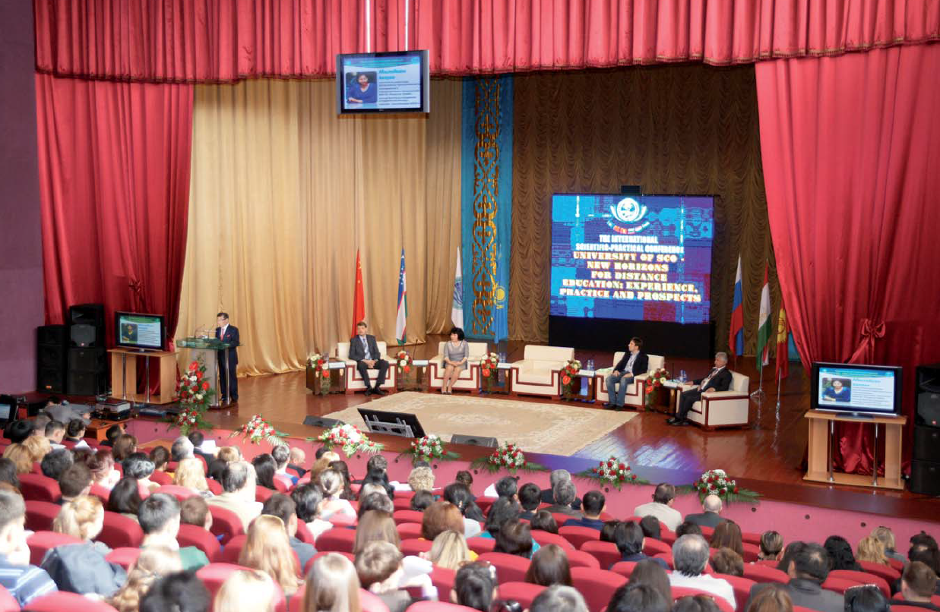
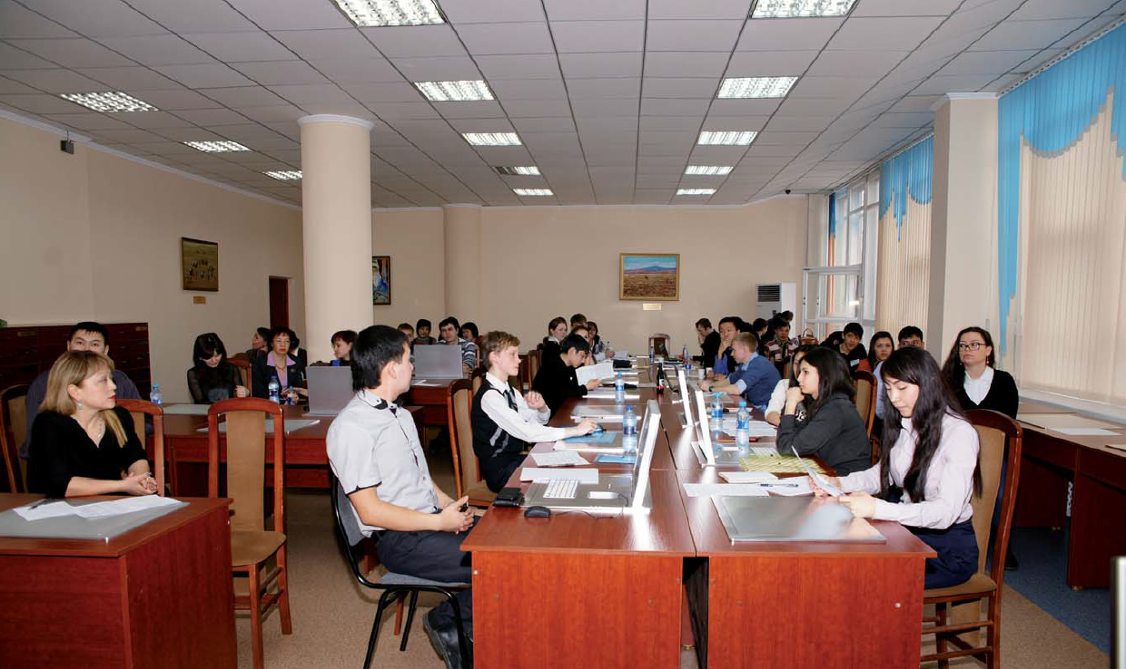

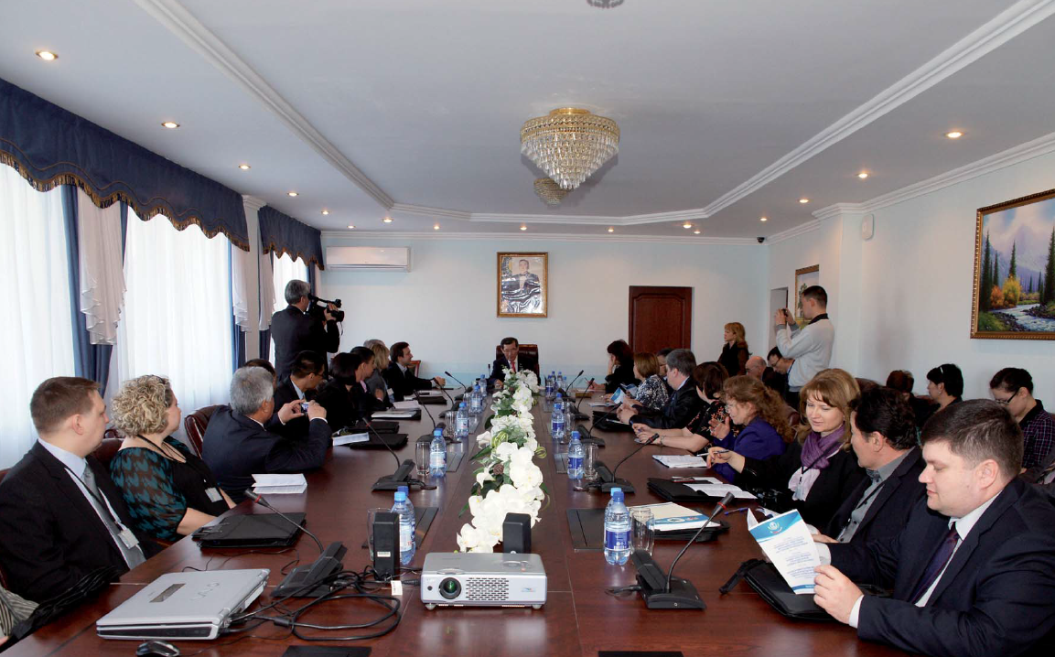
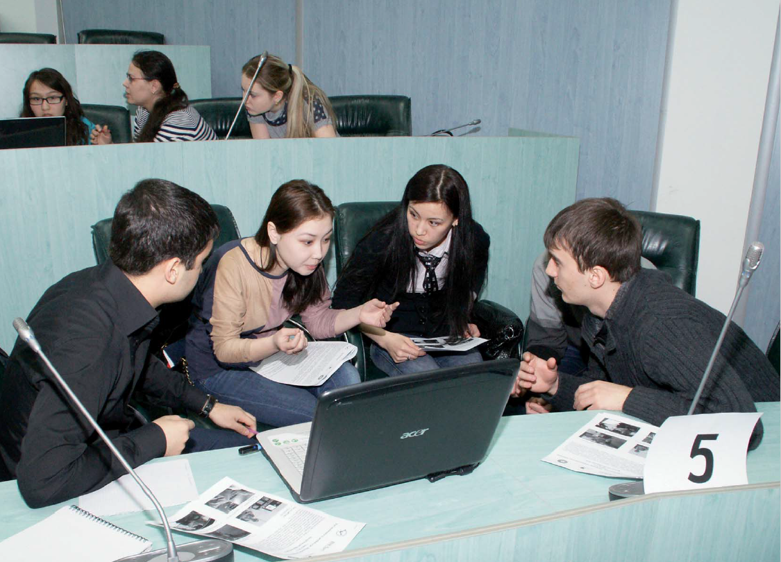

Slide 8


About KEUK
Issues of international cooperation are coordinated by the Center of international programs and projects aba academic mobility.
Today KEUK maintains sustainable relationships with more than 98 universities from 22 countries around the world - USA, United Kingdom, Turkey, South Korea, China, Germany, Spain, Italy, Malaysia, Austria, Hungary, Czech Republic, Bulgaria, Poland, Russia, Ukraine, Belorussia, Uzbekistan, Kyrgyzstan, Tajikistan, Moldova, Lithuania, Latvia. Every year the amount of partners is increasing.
In the framework of international cooperation in 2006 in Bologna city university signed Great Charter of European Universities.
University is a part of several international associations: International Association of Universities, Magna Charta Universitatum, Association of education institutions Educational Network (EdNet). Council of cooperative universities of the CIS countries, Association of Law Schools, the Eurasian Association of Economic Universities, the European Universities Association (EUA).
www.keu.kz

Slide 9
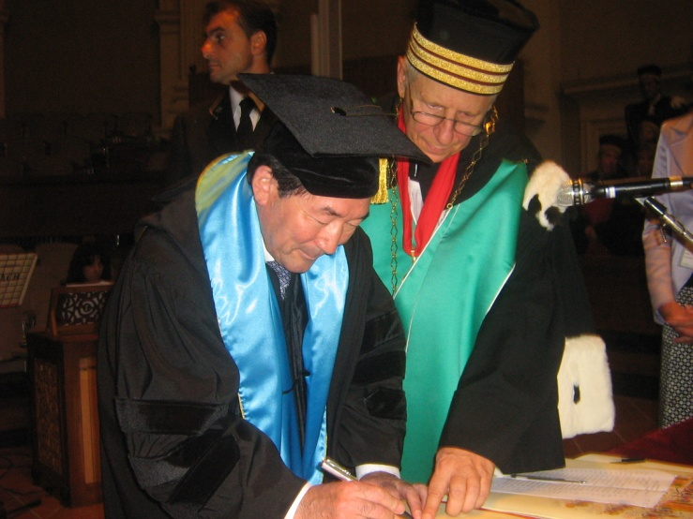

About KEUK
In 2007-2008, the University took part in the project "The concept of interface competences" HEI-entrepreneurship”. Participants in the project were: Higher School of small and medium enterprises (Bielefeld, Germany), the Foundation "Education and Craft" (Germany), University "Unikonzalt" (Paderborn, Germany), Graduate School of Carinthia (Villach, Austria), Kazakh Economic University. T.Ryskulov (Almaty, Kazakhstan).
Today university is a participant of the research project «Modeling Macroeconomic Effects of Environmental Regulation in Kazakhstan in Computable General Equilibrium» (CGE). The project coordinator is Institute of East and South-East European research (Regensburg, Germany). Project is aimed on the investigation of various ecological issues of Kazakhstan: use of water resources, emissions of carbon dioxide, etc.
www.keu.kz

Slide 10
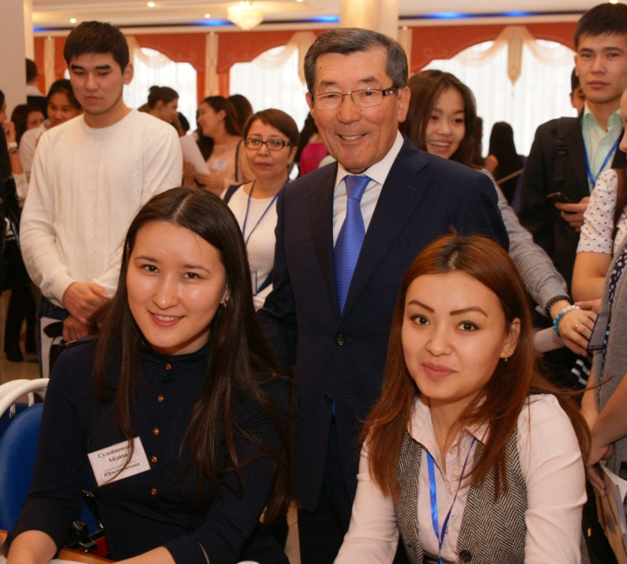
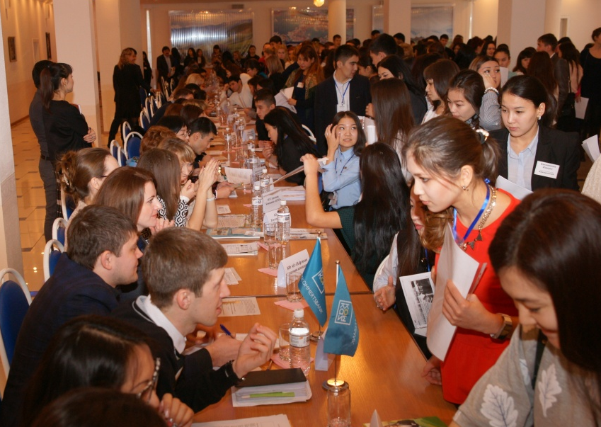
About KEUK
This year, Karaganda Economic University is also involved in the European project of master students exchange between Kazakhstan and European universities and the training of professors reading master-level courses in English. In Kazakhstan, the project is supervised by the Trade Union Federation of the Republic of Kazakhstan, the European University - coordinator is Belgian Free University, partner university from Kazakhstan is Karaganda Economic University.
In 2015 the university has won the opportunity to participate in 2 international Erasmus+ 1) “Creation of Central-Asian center for teaching, learning and entrepreneurship” and 2) “Creation of competence and employment centers”.
www.keu.kz

Slide 11
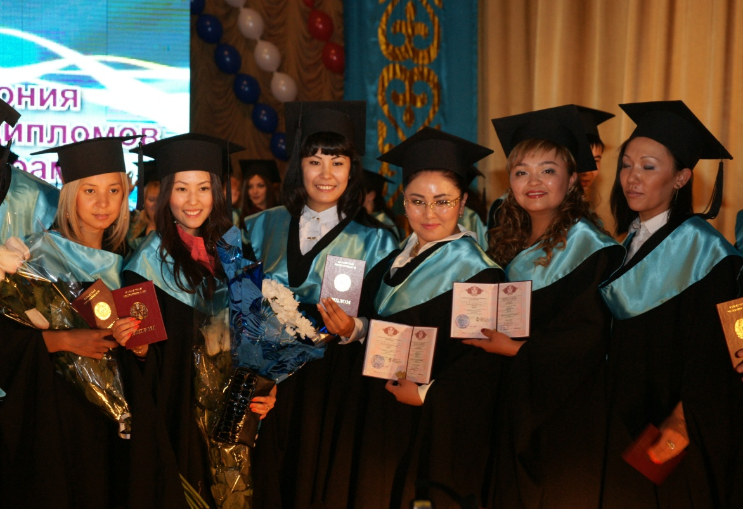
About KEUK
Students mobility in the university is realized through following programs: within the network of the University of Shanghai Cooperation Organization, in the direction of “IT-technologies” and “Economics”; within exchange programs organized by the International Business School Solbridge (South Korea), University of Applied Sciences Carinthia (Austria), University of Applied Sciences named after Y.Kodolani (Hungary), PFUR (Russia), NRU-HSE (Russia), Financial University under RF Government, Ural state law academy, Kiev national university named after T.G. Shevchenko, Malaysia technology university of Kuala-Lumpur and exchange programs in the framework of student mobility program Erasmus +.
In 2015 our students firstly gained a possibility to study in USA. Two students with the majors in: “Accounting and Audit” and “International Relationship”, with the support of the rector are now studying in Pittsburg State University (Kansas, USA).
www.keu.kz

Slide 12
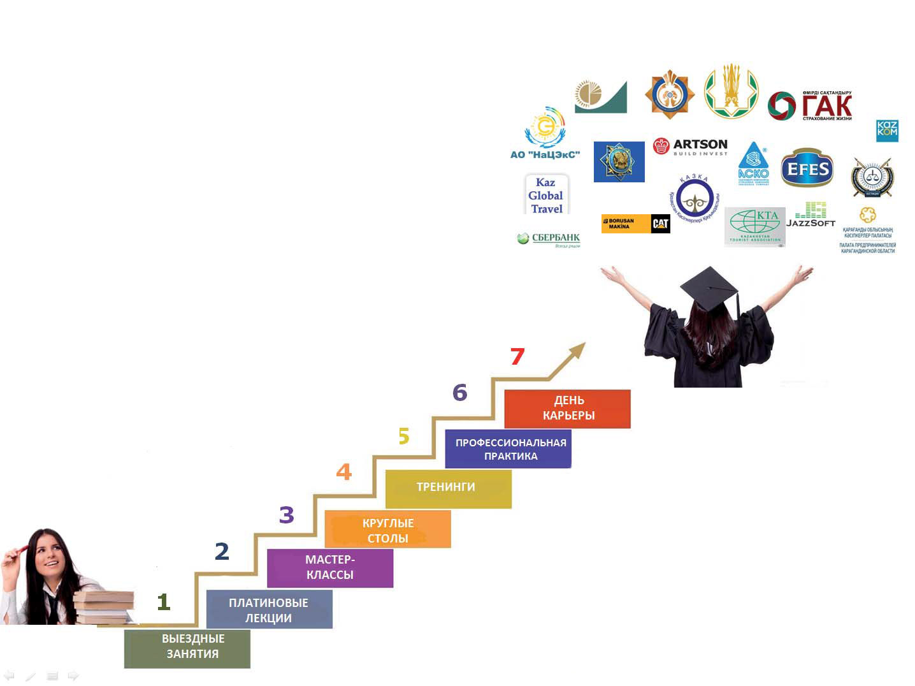
About KEUK
On the 1st of October 2015 the Department of strategic development was created, one of the department’s main functions is the organization of professional practice and employment of the graduates..
The Components of graduates’ successful employment.
www.keu.kz

